Slide 1
Predicting locations for a new pet supply store in the Austin, Tx area
Michelle Skibitzki
March 9, 2020

Slide 2
Predicting ideal locations for a new pet supply store is valuable for small business owners
Small business owners are dependent on word of mouth and have difficulty competing with the large box stores for business.
Predicting ideal locations for new small business pet supply stores helps find the areas that are already saturated with other pet stores, in comparison with area populations where a market might becomes too competitive, so the small stores may not be able to keep up.

Slide 3
Data Acquisition and Cleaning
Geo locations for Travis and Williamson counties, along with the geo locations for all major cities gathered from https://latitude.to/articles-by-country/us/united-states/
List of the major cities in Travis and Williamson counties, along with populations of those cities gathered from https://www.zip-codes.com/county/
Cleaned city data left 17 cities assessed. Across those 17 cities, 100 existing pet stores per city was compared.
Data provided that did not directly influence the outcome of the data was dropped. (ie: cities with a population of 0, but existed for postal data only)

Slide 4
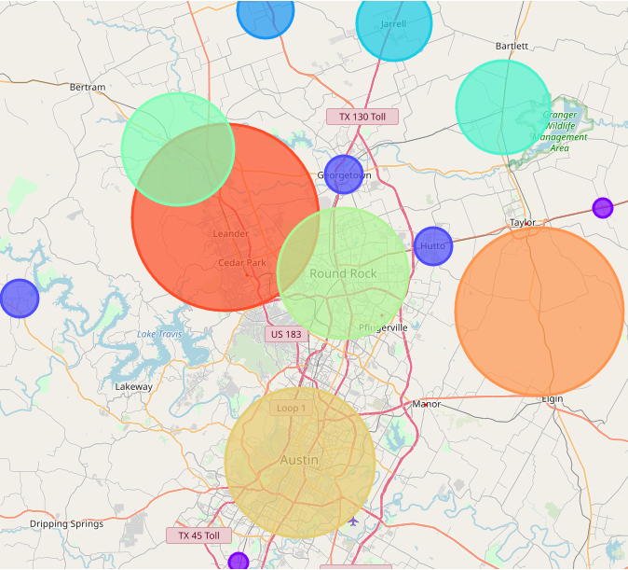
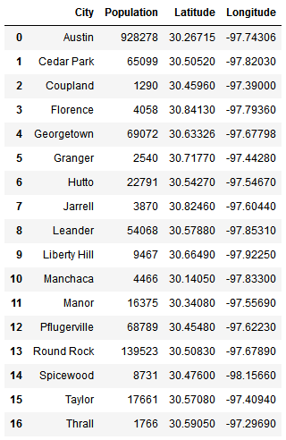
Using Population Data and Foursquare Venue Assessments
Population data and exiting pet stores utilized
to graphically demonstrate where the markets
are already saturated.

Slide 5
Conclusions and Future Assessments
Based on the mapping data and information provided, the best location to start a new Pet Supply store where there is not already a large number of stores would be in the Pflugerville area along the I-130 corridor to Manor.
This is a first-order solution to the question “Where is the best place to open a new pet supply store near Austin, Texas?” Using public datasets, we are able to, at least partially, address a few factors we have mentioned at the beginning: population and existing saturation of pet stores. We also carry out a very simple competitor analysis based on the distribution of pet stores in the chosen Travis and Williamson counties.
Further analysis would need to take into consideration cost of opening the store in the locations, along with ease of access to the business at those locations.

